Slide 1
DATA MODELING &
ER DIAGRAM BASICS
Database Concepts
Spring 2021
Week 2

Slide 2
Data Modeling and Data Models
Data modeling: Iterative and progressive process of creating a specific data model for a determined problem domain
  Problem domain: A clearly defined area within the real-world environment, with a well-defined scope and boundaries
Data models: Simple representations of complex real- world data structures
  Useful for supporting a specific problem domain
  Model: Abstraction of a real-world object or event
  Database models: an implementation of a data model in a specific database system

Slide 3
The Data Model
A data model is a plan or blueprint for a database design.
A data model is more generalized and abstract than a database design.
It is easier to change a data model then it is to change a database design, so it is the appropriate place to work through conceptual database problems.
Notes:
Data model is the first step in designing a database

Slide 4
Importance of Data Models
Are a communication tool
Give an overall view of the database Organize data for various users
Are an abstraction for the creation of good database

Slide 5
Data Model Basic Building Blocks
Entity (Table)
  Unique and distinct object in the real world; used to collect and store data
    e.g.) person, place, thing, event, concept
Attribute (Field)
  describe an entity’s characteristics
  Relationship
  Describes an association among entities
  One-to-many (1:M)
  Many-to-many (M:N or M:M)
  One-to-one (1:1)
Constraint
  Set of rules to ensure data integrity (Not Null, PK, FK)
  Restriction placed on the data (Check)
Notes:
• An employee’s salary must have values that are between 6,000 and 350,000.
• A student’s GPA must be between 0.00 and 4.00.
Each class must have one and only one teacher

Slide 6
Primary Key and Foreign Key
A primary key (PK) is an attribute or combination of
attributes that uniquely identifies any given row.
A foreign key (FK) is the primary key of one table that has been placed into another table to create a common attribute.

Slide 7
Entity Relationship Diagram (ERD)
Graphical representation of entities and their relationships in a database structure
ERD decribes the:
  Conceptual database as viewed by end user
  Database’s main components
    Entities
    Attributes (keys and non-key attributes)
    Relationships
Notes:
The most popular type of data model known as an entity relationship diagram, or ERD.

Slide 8
Naming Conventions
Entity names - Required to:
  Be descriptive of the objects in the business environment
  Use terminology that is familiar to the users
  Singular
Attribute name - Required to be descriptive of the data
represented by the attribute
Proper naming:
  Facilitates communication between parties
  Promotes self-documentation
All lowercase letters for the class assignments

Slide 9
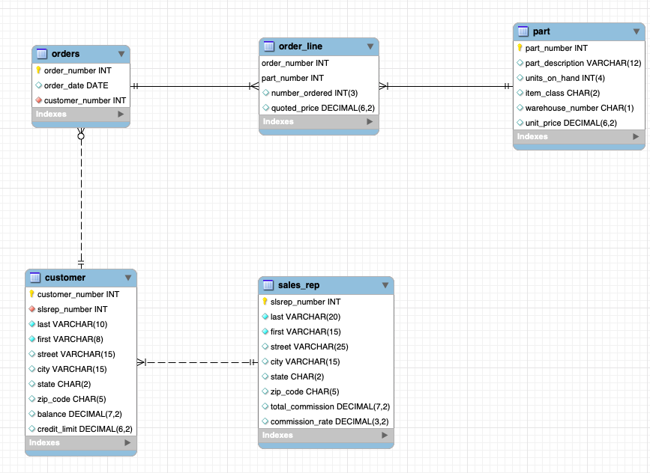

Slide 10
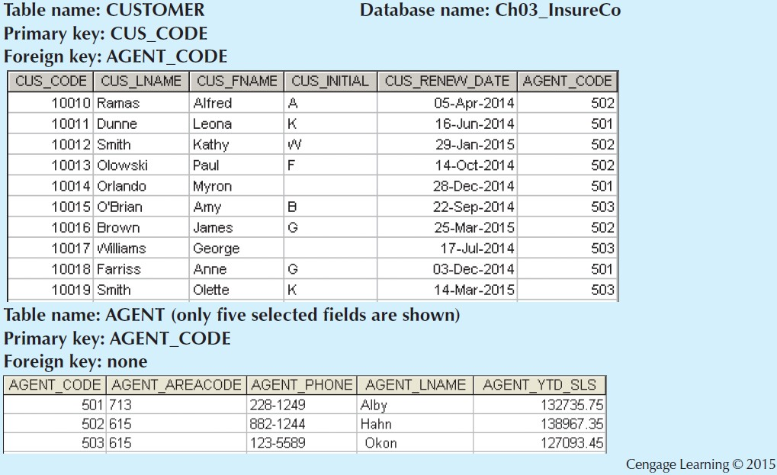
Notes:
Tables are related to each other through the sharing of a common attribute. The common link between the CUSTOMER and AGENT tables enables you to match the customer to his or her sales agent, even though the customer data are stored in one table and the sales representative data are stored in another table. Although the tables are independent of one another, you can easily associate the data between tables. The relational model provides a minimum level of controlled redundancy to eliminate most of the redundancies commonly found in file systems.

Slide 11
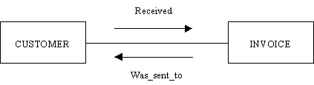
Relationship Names
A relationship name is a named association between
entities.

Slide 12
Relationships
Association between entities that always operate in both directions
Participants: Entities that participate in a relationship
Connectivity: Describes the relationship classification (relationship type)
Cardinality: Expresses the minimum and maximum number of entity occurrences associated with one occurrence of related entity
Notes:
The entities that participate in a relationship are known as participants, and each relationship is identified by a name that describes the relationship.
Cardinality expresses the minimum and maximum number of entity occurrences associated with one occurrence of the related entity.

Slide 13
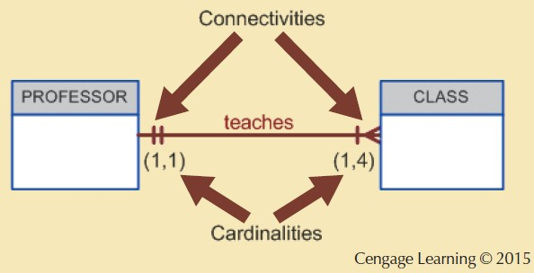
Connectivity and Cardinality
Notes:
The connectivity of a relationship is its classification. It may be a one to one (1:1), one to many (1:M) or many to many (M:N) relationship.
The cardinality of a relationship is the number of instances of entity B that can be associated with entity A. There is a minimum cardinality and a maximum cardinality for each relationship.
In the ERD, cardinality is indicated by placing the appropriate numbers beside the entities, using the format (x,y). The first value represents the minimum number of associated entities, while the second value represents the maximum number of associated entities.
Here, the cardinality (1,4) next to the CLASS entity in the “PROFESSOR teaches CLASS” relationship indicates that each professor teaches up to four classes, which means that the PROFESSOR table’s primary key value occurs at least once and no more than four times as foreign key values in the CLASS table. If the cardinality had been written as (1,N), there would be no upper limit to the number of classes a professor might teach. Similarly, the cardinality (1,1) next to the PROFESSOR entity indicates that each class is taught by one and only one professor. That is, each CLASS entity occurrence is associated with one and only one entity occurrence in PROFESSOR.

Slide 14
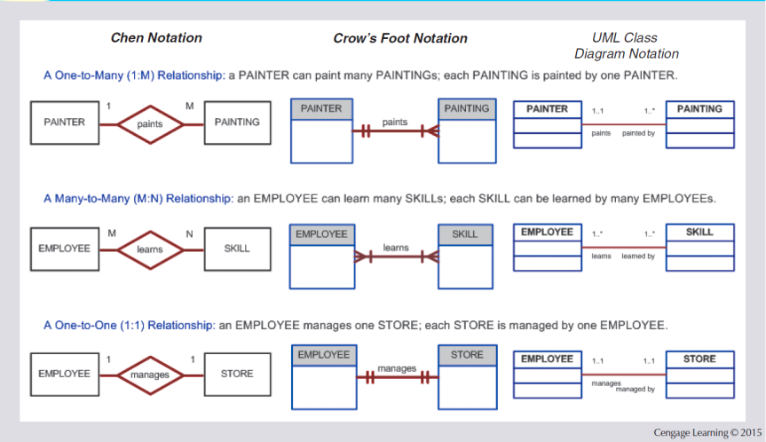
Figure 2.3 - The ER Model Notations
Notes:
the original Chen notation: the connectivities are written next to each entity box. Relationships are represented by a diamond connected to the related entities through a relationship line. The relationship name is written inside the diamond.
the Crow’s Foot notation: the connectivities are represented by symbols. the relationship name is written above the relationship line.
the newer class diagram notation, which is part of the Unified Modeling Language (UML): the connectivities are represented by lines with symbols (1..1, 1..*). Also, the UML notation uses names in both sides of the relationship.

Slide 15
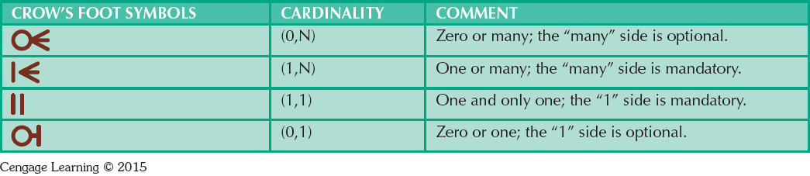
Crow’s Foot Symbols

Slide 16
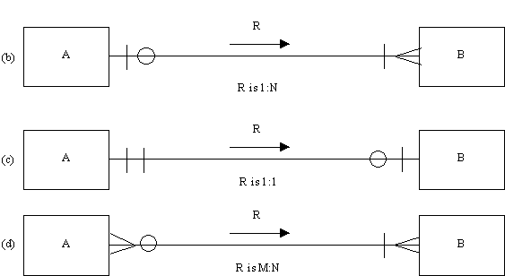
Relationship Type
minimum # of records of “B” that can be associated with one record of “A”
maximum # of records of “B” that can be associated with one record of “A”
Notes:
Look at (b) customer and agent connectivity.
The connectivity of a relationship is its classification. It may be a one to one (1:1), one to many (1:M) or many to many (M:N) relationship.
The cardinality of a relationship is the number of instances of entity B that can be associated with entity A. There is a minimum cardinality and a maximum cardinality for each relationship.
First example: A: order; B: item
Second example: A: person; B: library account
Third example: A: teaching assistant; B: course

Slide 17
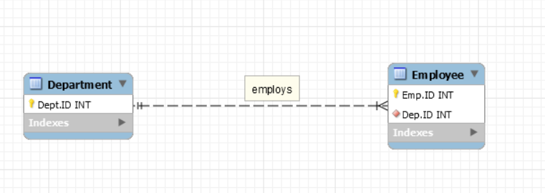
Relationships
A department can employ many employees; each employee can only work in one department. (1:M)
Notes:
The relationship type is one to many

Slide 18
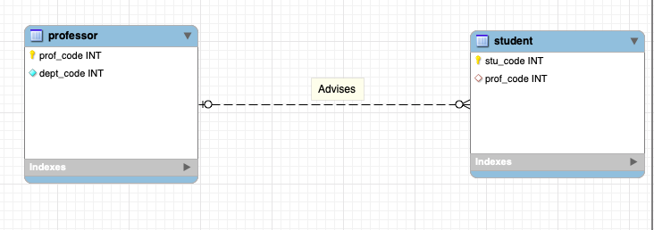
Notes:
The relationship is one to many
Each professor can advise many students; each student can be advised by one professor.

Slide 19
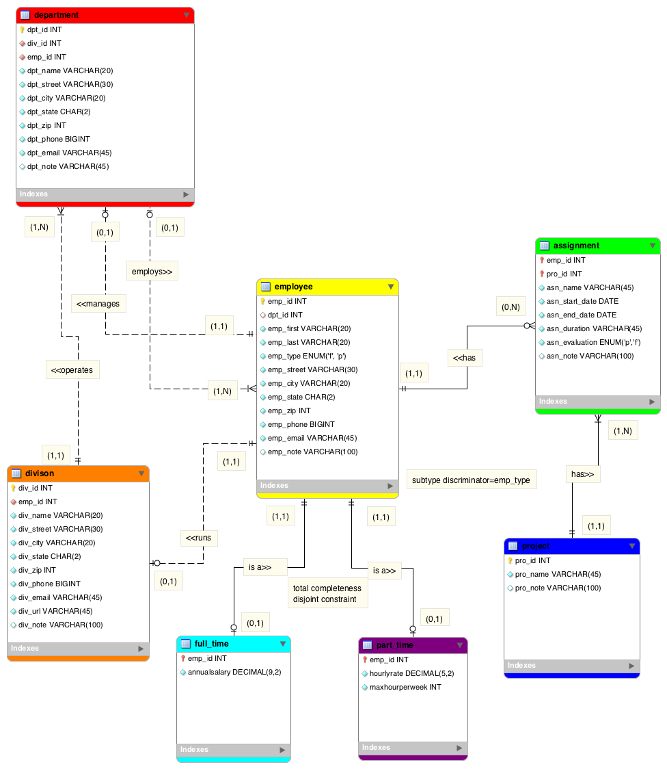
Notes:
How many entities in this ERD?
Department employs Employee relationship: One-to-Many relationship. Department is optional in this relationship.
Division operates Department relationship: one-to-Many relationship. Both entities are mandatory in this relationship.
Employee has Project relationship: Many-to-Many relationship. Need to create an associative entity (called assignment) to split it to two one-to-many relationship.
Employee has Assignment relationship: One-to-Many relationship. Assignment is optional in this relationship.
Project has Assignment relationship: One-to-Many relationship. Both entities are mandatory in this relationship.
Employee manages Department relationship: One-to-One relationship. Department is optional in this relationship.
Employee runs Division relationship: One-to-One relationship. Division is optional in this relationship.

Slide 20
Business Rules
Brief, precise, and unambiguous description
of a policy, procedure, or principle
Enable defining the basic building blocks
Describe main and distinguishing characteristics of the data
Notes:
From a database point of view, the collection of data becomes meaningful only when it reflects properly defined business rules.

Slide 21
Business Rule Examples
An EMPLOYEE has one or more COMPUTERs. A COMPUTER has only one assigned EMPLOYEE.
Parents meet with the teacher, and the teacher is met by parents.
“An agent can serve many customers, and each customer
may be served by one agent” (p. 44, Chapter 2).
“One customer can generate many invoices. Each of the many invoices is generated by only one customer” (p. 49,Chapter 2).
“A training session cannot be scheduled for fewer than 10 employees or for more than 30 employees” (p. 4, Chapter 2).

Slide 22
Translating Business Rules into
Data Model Components
Nouns translate into entities
Verbs translate into relationships among entities
Relationships are bidirectional
Questions to identify the degree of relationship type
  How many instances of B are related to one instance of A?
  How many instances of A are related to one instance of B?
Example:
  How many classes can one student enroll? Answer: many classes.
  How many students can enroll in one class? Answer: many students.
  The relationship between student and class is many-to-many (M:N).

Slide 23
Examples from A#1
RQ 6:
“A customer can make many payments,
but each payment is made by only one customer.”
Problem #2:
“An agent serves many customers,
but each customer is served by only one agent.”

